Slide 1
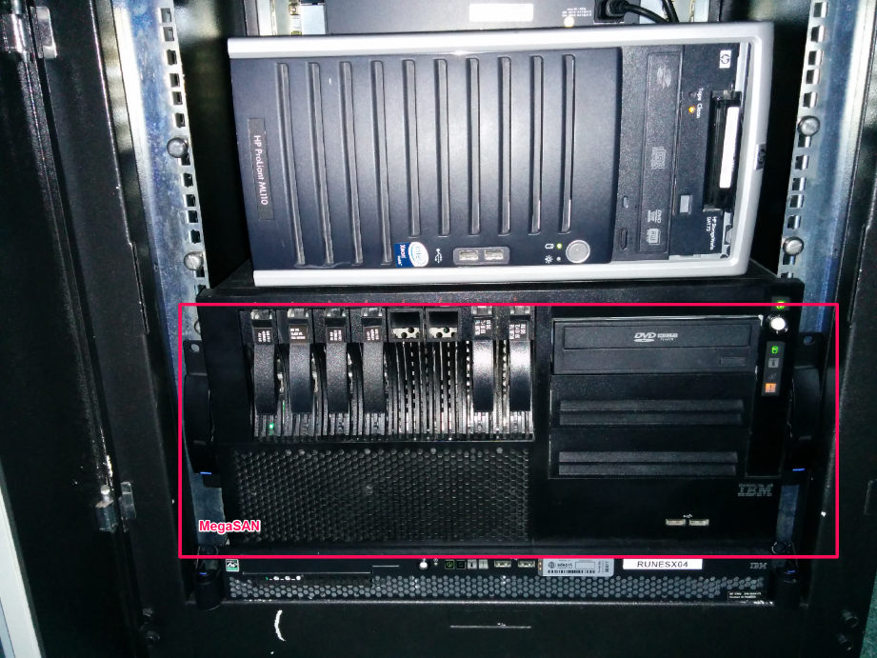
Homelab Storage
And the lessons learnt
By James Kilby @Jameskilbynet
Notes:
Welcome to VMUG
Thank you all coming
Thank Steve and Nathan
Introduce me…
USB for any good questions

Slide 2
About me
Working with VMware since early 2008 ESX(i) 3.5
Currently work as a Systems Analyst for Adept4, UK based managed service provider
Manage an estate of approx. 80 Hosts split across 4 DC’s and customer sites serving global companies.
Run mini data centre at home ☺
Notes:
Thank Adept4

Slide 3
Intro
Reasons for talking about storage
First steps into Homelab
Later editions
Tools currently in use
Lessons and Real world applications.
Next steps…..
Notes:
Why talking bout homelab storage
Early days – Typically spare SATA drives 7.2k limited IOPS

Slide 4
Storage what are your options ??
Roll your own??
Buy Synology, Iomega or similar ?
Converged options ?? VSAN or Nutanix
New options all the time …..
What do you do ??
Notes:
If I did it again prob go synology route for the WAF and the electric bill.
Learnt a lot on the way. Would never understand that with an off the shelf solution

Slide 5
First baby Steps 2009ish
Direct Attached SATA in VMware host
Upgrade to SCSI Raid with -WAF very low
Shared storage required for all the funky features HA, vMotion Svmotion, FT
V2 required

Slide 6
Shared Storage Route
Tested a few Opensource options, finally settled on Nexenta
Built on ZFS foundation
Web managed
Promised great performance
Used at VMWorld 2011 to run large part of the Hands on Labs
Notes:
Experimented with all ran Openfiler in production in a small environment for 18 months
Talk bout ZFS as foundation for Nexenta Wikipedia….

Slide 7
Nexenta SAN/NAS feature set
Thin Provisioning
Compression
Inline Dedupe
iSCSI with fully supported VAAI
FC (Enterprise edition)
NFS
SMB
FTP
AD integration
Built in Snapshots
Data integrity baked in
ZFS Sync
Notes:
Data integrity - Every block stored in disk ssd or ram is checksummed. Always checked on read.

Slide 8
VSA -- 1st implementation of Nexenta as a Virtual Machine 2010
Functionally fine v3.1.x
Perfomance was ☹
Problems with network drivers (e1000 only)
Random utilisation bug when using multiple cores
Problems with giving it enough ram and compute in hosts available at the time.
SSD out of budget

Slide 9
V2
HP ML110 G5 Host 8gb ram
Step change in performance over the VSA
2x 500Gb SATA disks in a mirror.
Performance was acceptable but not exceptional…..
Performance could have been improved with an SSD as a ZIL

Slide 10

Current Platform v3.0 MegaSAN
IBM x3550 Server
Nexentastore CE 4.X
2x Quad Core Xeon Processors
24GB Ram
2x 15k 72GB SAS OS disks
4x 15k 450GB SAS Storage
1x 64GB SSD as L2ARC
1x 80GB as ZIL
4x 1GB Nics
Notes:
Prob overkill came about as work donated the compute host. IBM 8xCPU and 48GB ram…..

Slide 11
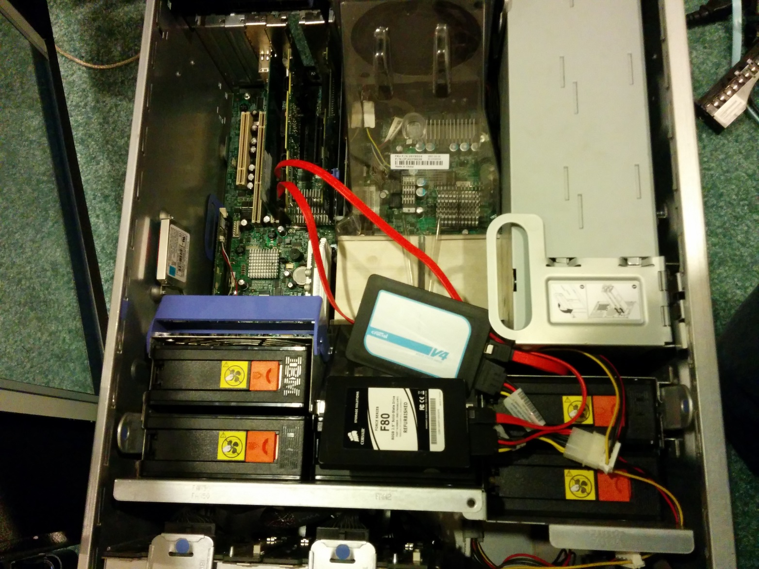
Additional LSI Controller For SSD/ Performance
Notes:
I added an extra storage controller and some SSD’s……

Slide 12
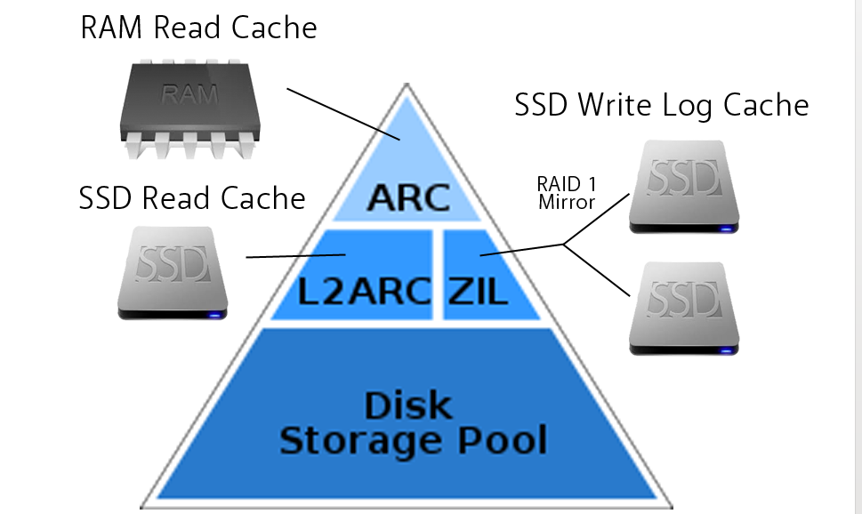
Architecture of ZFS

Slide 13
The Cost of an I/O in CPU time
L1 Cache 3 Cycles
L2 Cache 14 Cycles
Ram 250 Cycles
Disk 41,000,000 Cycles

Slide 14
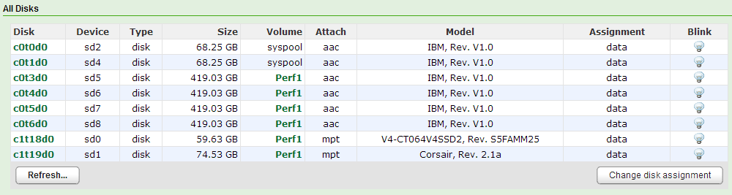
All Disks
Notes:
Explain the SAS are RAID 0 not the optimal pass through with 256 MB BBWC

Slide 15
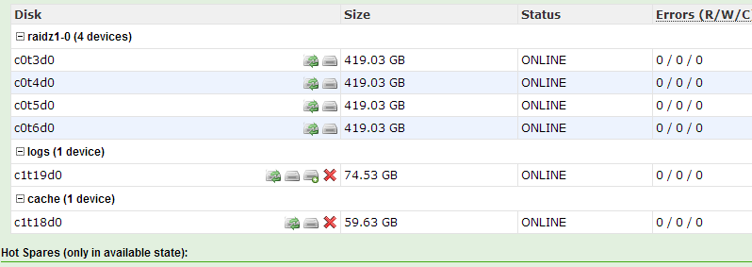
Perf1 Layout
Notes:
ARC Not raided explain why not needed different to HP sans/ EMC FAST sub lun move
Logs not raided ( Explain acceptable risk)
ZFS intent Log Logs would typically be very small ssd 2x 5s worth of writes Corsair has much higher write speed hence this one used.
Crucial has high read but low write speed ( v Cheap ssd
Explain Raid z1 equivalent to Raid 5

Slide 16
Cache ARC & L2ARC (RAM & SSD Cache)
Random I/O typically dominates VMware environment’s This is especially true when using larger pools
ARC is Ram based caching. ARC sized at all of your RAM available after OS (1GB) is loaded. 23GB in my case
Cache is king, Always be aware of your working set size. If it can fit in RAM performance is huge Any I/O served from RAM or SSD means that the disks didn’t need to do it.
Nexenta has advanced caching mechanisms for handling:
Most frequently accessed data
Most recently accessed data
Metadata
Notes:
By serving read i/o from cache ( either ARC or L2ARC ) free’s up disc time to do more writes
Question audience on why random i/o is so important

Slide 17
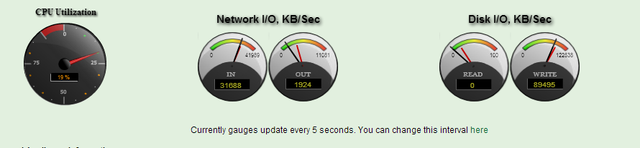
Nexenta serving 2MB/S with 0 Disk I/O
Notes:
2mb/s being served with no disk reads happening.
Also more storage writes happening than input describe

Slide 18
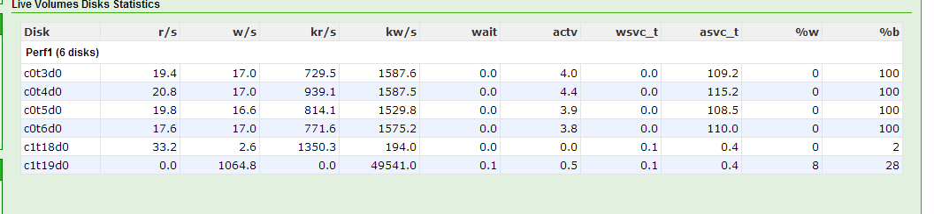
Hammering the box ARC and ZIL at work
Notes:
explain what they are seeing disks are 100% busy
L2arc is serving more reads than the disks at less busy time
All writes going to ZIL with no reads

Slide 19
Slower disks
How does cache effect what you purchase ?
Can you buy slower cheaper disks and let the caching mechanisms handle the peaks ?
Does anyone already do this ?
Notes:
Discussion

Slide 20
Compression
Compression is handled at the pool level in Nexenta
Recommended to be Always on.
Performance usually improves!!!
Healthy storage utilisation improvement 30-40% typically
Nexenta 4 introduced compression on L2ARC making ur SSD investment go even further
Notes:
Performance usually improves Recommend LZ4 Algorithm fast- good compression… Includes early abort. If cant beat 12.5%
Compression is multi threaded. More cores the better

Slide 21
Dedupe
ZFS Dedupe’s Inline.
Use with Caution!!
Some very rough numbers - 30Gb of RAM for every 1TB of deduped storage if performance is important or 5GB of SSD as L2ARC if performance isn’t critical
Like compression its handled at the volume level
Performance of array can be severely effected if not specced properly
If enabled can not be turned off easily.
Notes:
Dedupe table stored in RAM for best performance . Considered metadata Default config is for ¼ ARC to be used for Metadata reserving ¾ for data
2 volumes 1 with dedupe on the other with it off

Slide 22
Some Key Lessons
Switching is key change from a Linksys Switch to HP Procurve (Both GB) massively changed iSCSI and SMB performance.
Always try and separate iscsi traffic wherever possible. Separate Nic’s separate switches or VLAN.
HP 1810-24G fanless is perfect homelab approx. £100
Notes:
CISCO 2960 cable placement ?
3x asic’s seen all iscsi on one side all data on the other

Slide 23
Hands on labs spec
4x Node HA Design
144GB Ram Per node
360x 2TB SATA disks
8x STEC ZEUS IOPS Modules
16x ZEUS Ram
List price for HW/ SW approx. $325,000
Notes:
Cheap ?? Going up against million pound EMC and 800,00$ Netapps

Slide 24
Performance achieved
154,000 4k NFS op/sec at sub 1m/sec latency
Highest bandwidth seen 1305 MB/S 928MB read 376MB write
All done at less than 2ms latency

Slide 25
Next on the list….
Experimentation with Fibre Channel ??
Not supported in the Community edition GUI but target mode can be set from the command line.
Ridiculously cheap on EBAY!!
Infiband is also possible and very cheap 20GB/s possible at home
HP VSA Cluster??

Slide 26
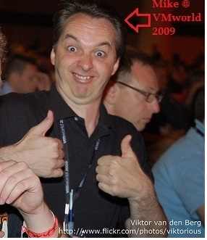
#Feed4orward
Feedforwarded by Mike Laverick
http://www.vmug.com/feedforward
Notes:
Vmware senior cloud evangelist

Slide 27
Any Questions ??

